Slide 1

THE MOST IMPORTANT PROTEINS IN YOUR BODY
ENZYMES

Slide 2
IF asked whether a reaction is POSSIBLE…
THE answer is always YES!

Slide 3
ANYTHING, as we know…
IS POSSIBLE!!

Slide 4
BUT if I asked whether something was PROBABLE…
The answer now changes to NO!!!

Slide 5
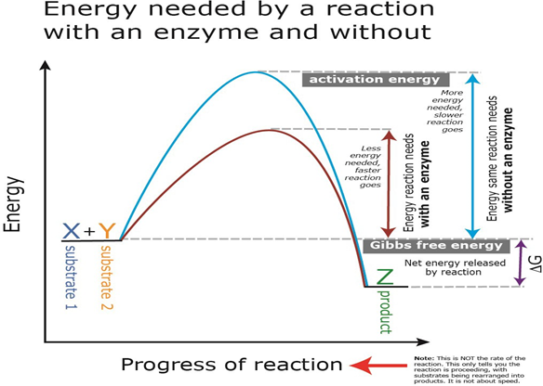
A Reaction
Figure 5.4 General Redox Reaction

Slide 6
An Enzyme…
Brings substrates together in space and time
Lowers the free Energy of activation
Stabilizes the hi energy intermediate
Is not consumed in the reaction

Slide 7
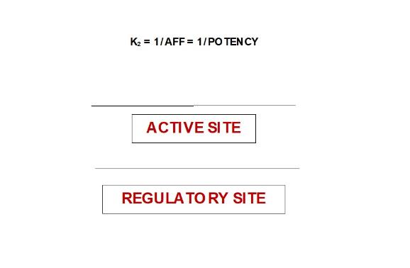
An ENZYME has…

Slide 8
Competitive Inhibition
Inhibitor is similar to the substrate
The inhibitor is competing for the active site
Affinity Is decreased
Km increases
Vmax remains the same (just add more substrate)
Reversible

Slide 9
Noncompetitive Inhibition
NOT similar to the substrate
Does NOT bind active site
Binds to regulatory site
Turns off the enzyme
Km remains the same
Vmax decreases
Irreversible

Slide 10
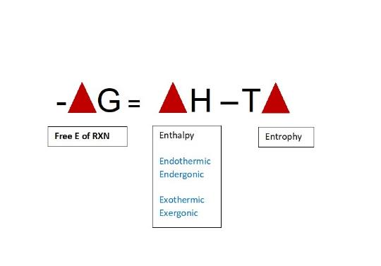
What makes a reaction favorable and spontaneous?
S

Slide 11
ATP
A – PO₄³⁻
PO₄³⁻
PO₄³⁻
-7300 cal
-7300 cal

Slide 12
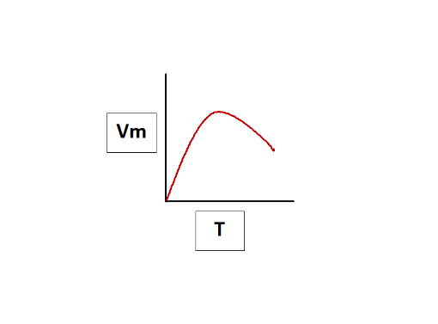
Effects of Temperature on a Reaction

Slide 13
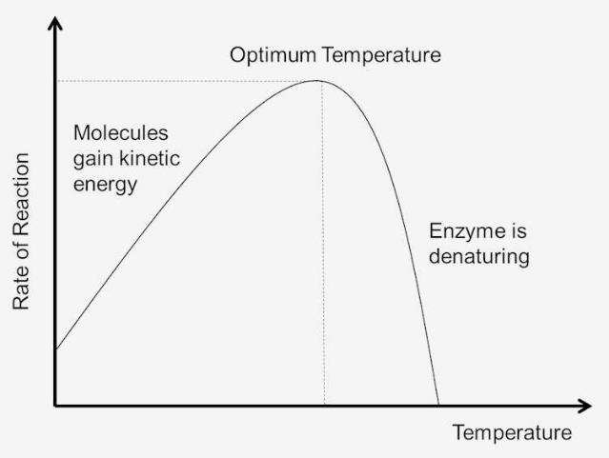
Effects of Temperature on a Reaction

Slide 14
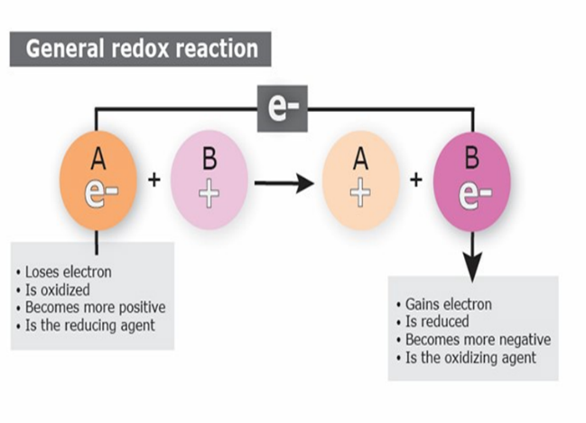
REDOX POTENTIAL
Figure 5.4 General Redox Reaction
You want it to be negative
When negative: has electrons to give
When positive: wants to accept electrons

Slide 15
Reducing Agent
Has a negative delta E
Wants to give away electrons
Gets oxidized after the reaction

Slide 16
Oxidizing Agent
Has a positive delta E
Wants to accept electrons
Gets reduced after the reaction

Slide 17
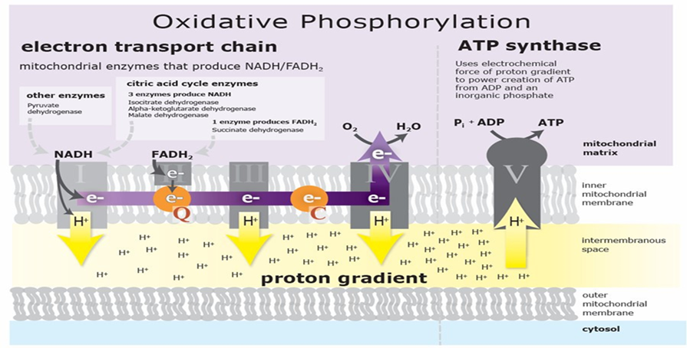
Electron Transport System
Figure 5.5 Electron Transport Chain

Slide 18
Inhibitors and Uncouplers

Slide 19
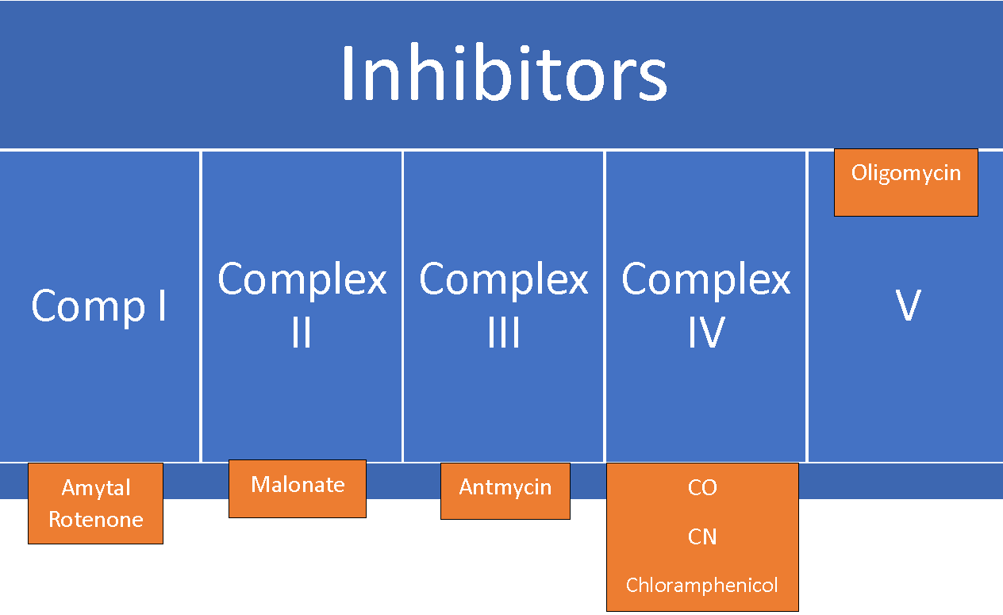
Inhibitors

Slide 20
Carbon Monoxide Poisoning
CO binds iron 200 times stronger than oxygen
Competitive inhibition of oxygen
Saturation will be normal
PO2 will be low
Treat with supplemental oxygen
The history is the best clue!

Slide 21
Cyanide Poisoning
Most common cause: Sodium Nitroprusside
  Best drug for any hypertensive crisis except in pregnancy or an aortic dissection
Treatment: Amyl Nitrite
  Vitamin B-12
  Methylene Blue
  Blood transfusion

Slide 22
Chloramphenicol
Blocks the 50s subunit by blocking peptidyl transferase
Covers all gram positives, including Staphylococcus aureus
Covers simple gram negatives
Covers Rickettsia
Affects all rapidly dividing cells
Aplastic anemia—dose-dependent and dose-independent
Gray baby syndrome

Slide 23
Uncouplers
DNP
ASPIRIN
FREE FATTY ACIDS
Allow electron transport system to continue
Oxidative phosphorylation and ATP synthesis stops
All energy is now release as heat

Slide 24
Diseases related to uncoupling
Malignant hyperthermia
Neuroleptic Malignant Syndrome
Muscles can contract but cannot release
Patient becomes stiffer and hotter
Treatment: Dantrolene
  Stabilizes sarcoplasmic reticulum and ryanodine arm so that there is no calcium for contraction

Slide 25
Microsteatosis
Pregnancy
Acetaminophen overdose
Reye’s Syndrome
Because of uncoupling, fats are being burned so fast, so that only small fat droplets left in just a few hours

Slide 26
Acetaminophen Overdose
Four-hour level decides whether to treat or not
If they present before 4 hours, check levels and keep in emergency room until 4-hour mark; give activated charcoal
If 4-hour level is elevated, give N-Acetylcysteine

Slide 27
Reye’s Syndrome
Aspirin overdose plus a viral infection of the liver
Liver burns itself out with all the heat it produced
Follow ammonia levels (GABA effect)
Liver will eventually regenerate

Slide 28
Macrosteatosis
Obesity
Alcohol
Large fat droplets have been sent to the liver but are not used due to a sedentary lifestyle

Slide 29
How to Name Enzymes
FIRST NAME of an enzyme IS the name of the SUBSTRATE
LAST NAME of an enzyme IS what you did to the SUBSTRATE

Slide 30
Last Names of Enzymes
Kinase
Phosphorylase
Isomerase
Epimerase
Mutase
Transferase
Transaminases
Lyase
Carboxylase
Synthase
Synthetase
Dehydrogenase
Hydrolase
Thio-

Slide 31
Last Names of Enzymes Cont.
Kinase
Phosphorylates the substrate using ATP
Phosphorylase
Phosphorylates the substrate using free phosphate (Pi)
Isomerase
Creates an isomer from the substrate.
An isomer has the same chemical make-up but a different structure

Slide 32
Last Names of Enzymes Cont.
Epimerase
Creates an epimer from the substrate
An epimer has the same chemical makeup and structure but differ around one chiral carbon
Mutase
Moves a side chain from one carbon to another carbon
Transferase
Transfers a side chain from one substrate to another

Slide 33
Last Names of Enzymes Cont.
Transaminases
Involved in transferring amino groups from or onto amino acids
Lyase
Cuts carbon-carbon bonds
Must use ATP
Carboxylase
Use carbon dioxide to create a carbon-carbon bond.
Must use ATP.

Slide 34
Last Names of Enzymes Cont.
Synthase
Multiple substrates are stacked together to create a product
No bonds are broken
Synthetase
Multiple substrates are stacked to create a product
No bonds are broken
However, ATP is used in the reaction
Dehydrogenase
A cofactor is used in the reaction
Someone is going to lose a hydrogen

Slide 35
Last Names of Enzymes Cont.
Hydrolase
Uses water to break a bond
Add –ase to which bond is being broken
Thio
Always added when a sulphur bond is broken in the reaction.

Slide 36
Coming to a screen near you…
THE PATHWAYS

